Slide 1
Mahder Low Cost and Low Power Computer Platform

Slide 2
About the System
Our System: - Mahder Computer Systems
Develop Low Cost & Low Power Computer Systems. We provide very cheap and yet highly advanced computers(Laptop & Desktop), Computer Labs and Computing Services to the public.
The project helps Students, Organizations and Institutions
By Solving the problems of Power, Cost, Reliability and Accessibility.
We offer computers integrated with our custom operating system and software.

Slide 3
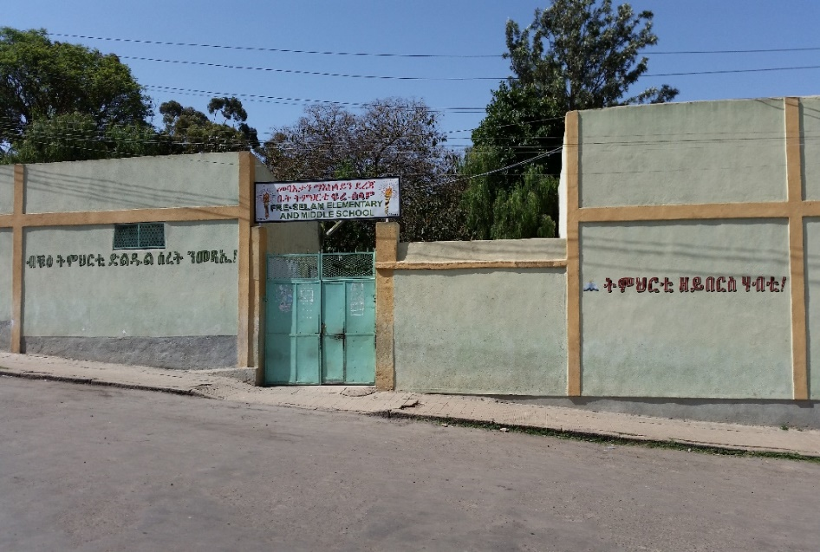
Motivation (existing PROBLEMS)
Computers are expensive to buy and maintain.
Computer Labs are expensive to install and maintain.
Students don’t have enough access to information since
there is no internet and schools don’t provide enough resources for students.
There is shortage of power and in remote areas there is no electricity.
There is no existing operating system and other applications in our languages.
Students knowledge and usage of computers is limited.
There is lack of teachers, esp. in remote areas.
Learning is expensive: to buy books, printing, transport

Slide 4
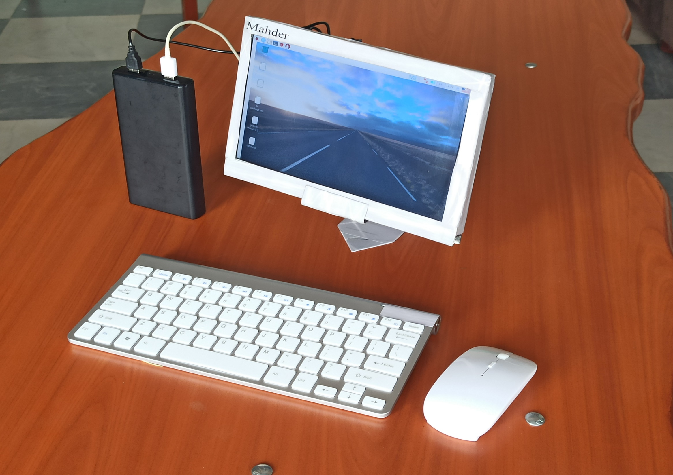

Slide 5
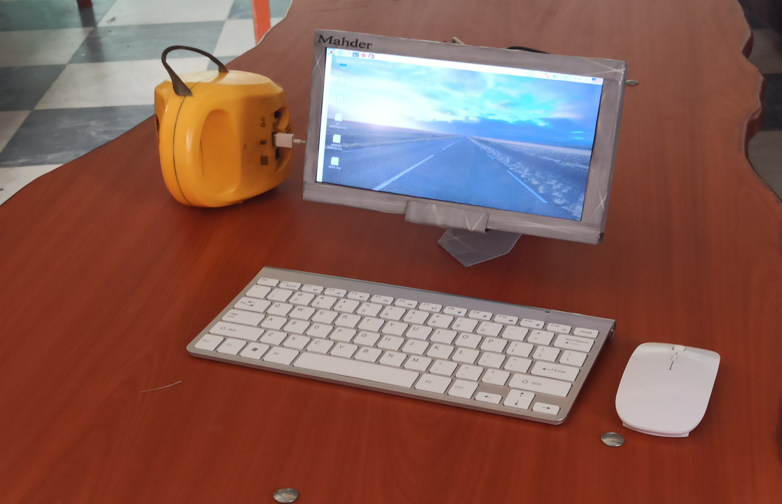

Slide 6
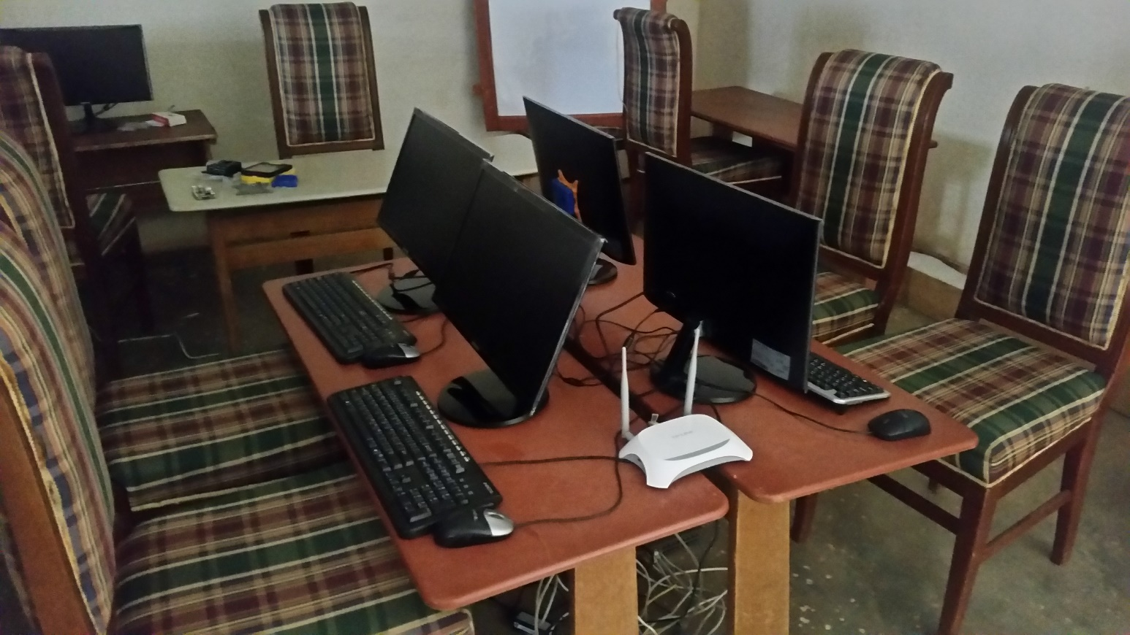

Slide 7
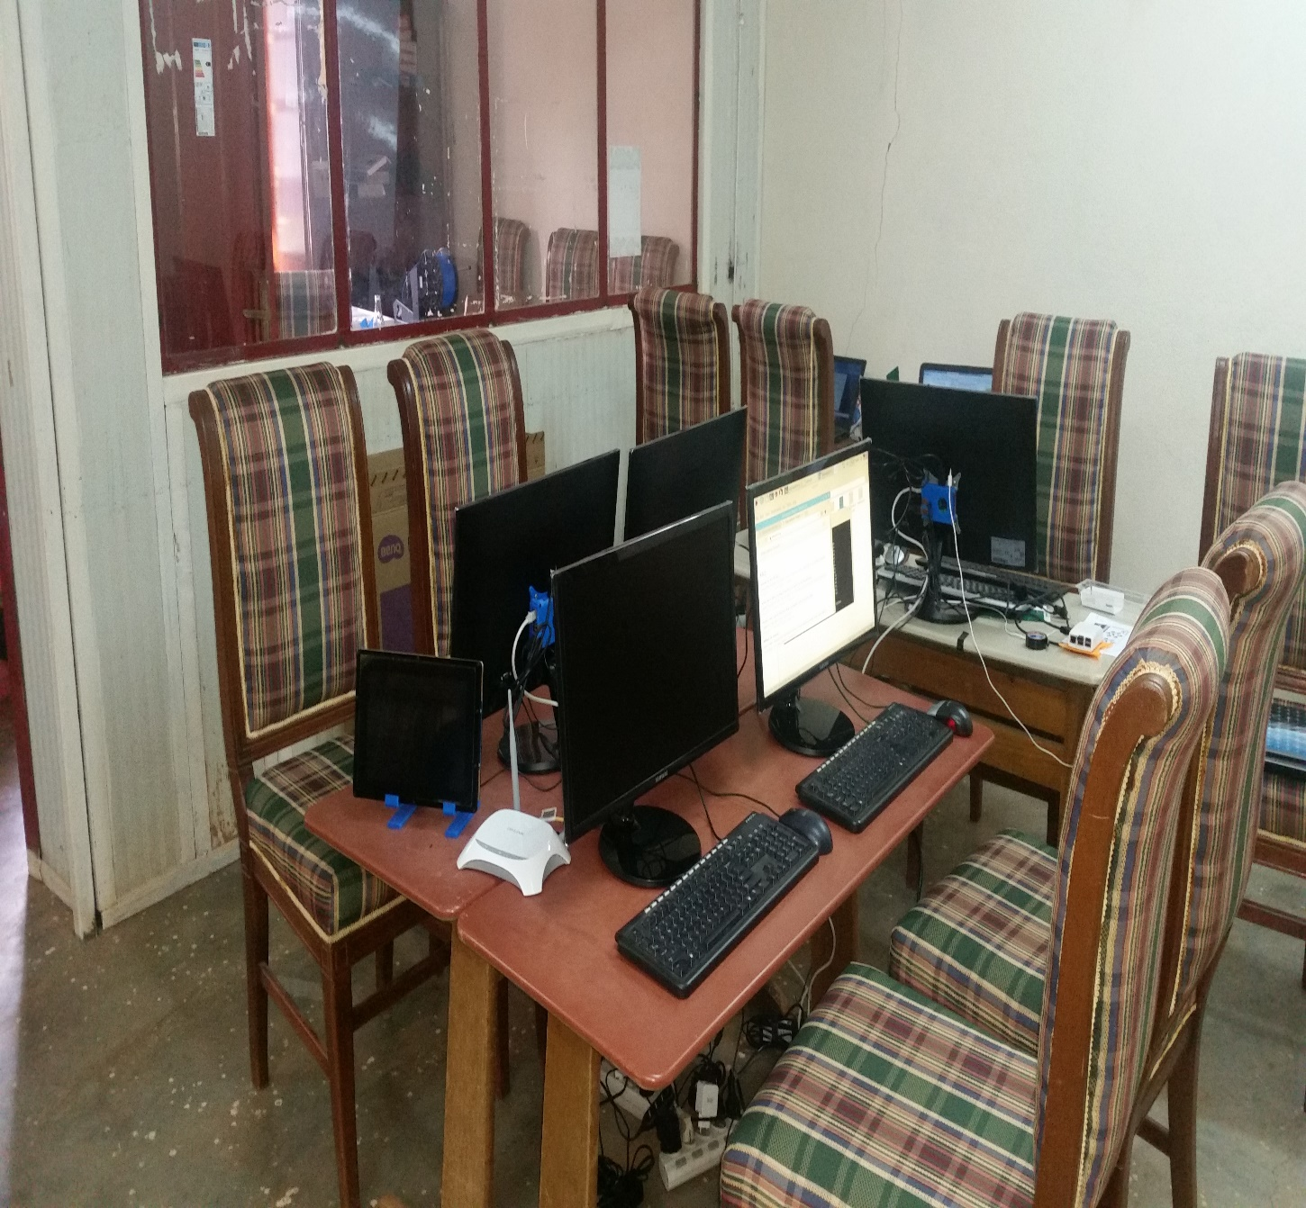
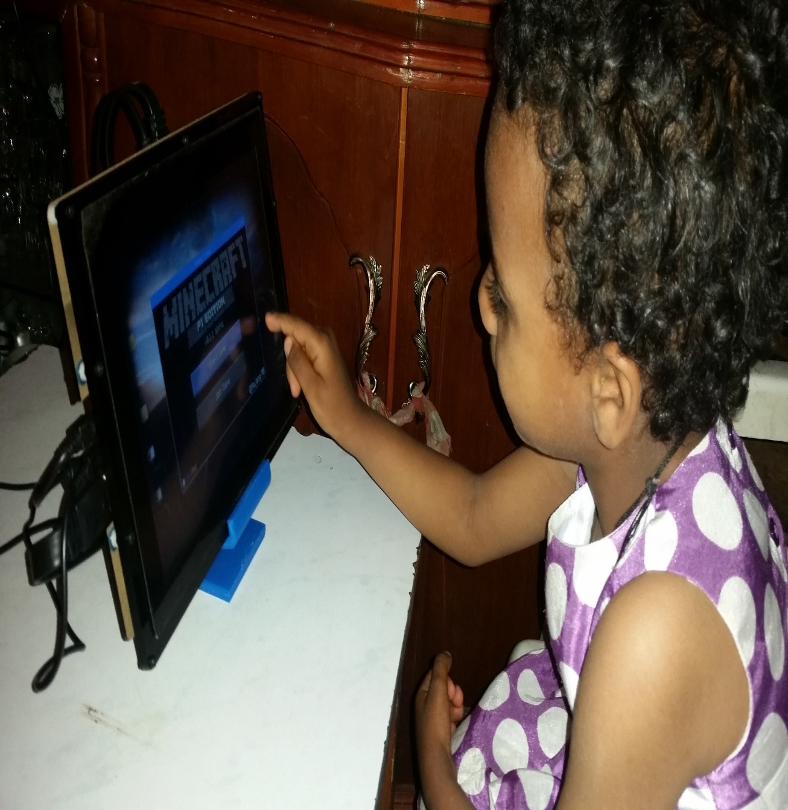

Slide 8
Visions & Goals of Mahder computer
Make computer cheaper and affordable.
Make information accessible for every one and every where.
Enable computing even though there is no electricity.
To help Vast and Variety part of the society
Make computing easier and better.
Make education and work better by using better technology and information access.
Low Cost, Low Power and Low bandwidth Systems.
Centralized Computing platform with a research capacities: Like super Computer

Slide 9
innovation
Hardware
Used Low cost & Low power board
Removed some power consuming & expensive parts
It consumes only 20 percent of other computers (that is 80% less).
Works with solar power or power bank.
Can re-use their old screens or TV monitors
Software
The system provides extremely big digital repositories for teaching, learning and research.
Search Engine
Tigrigna Operating System
5 Languages based web application
Tigrigna based Computer programming platform
Tigrigna translated computer games and educational aid

Slide 10
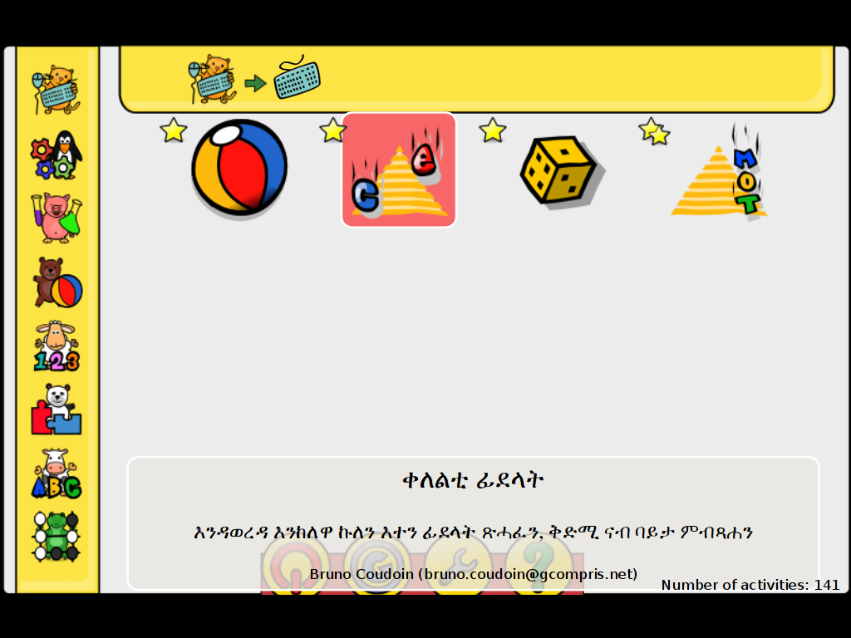
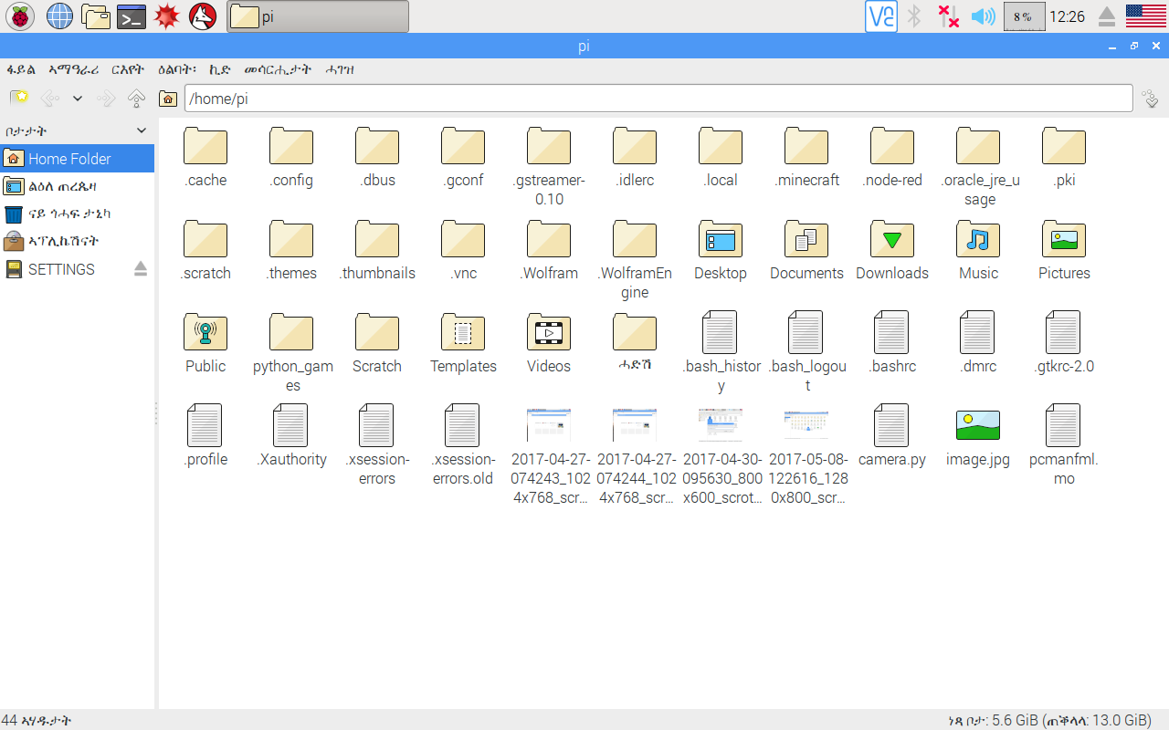

Slide 11
Advantages of the product
It consumes only 20 percent power of other computers (that is 80 percent less).
The system can work 24 by 7 without power interruption using small solar power.
It costs 20% - 30% of other computers. 1,300 to 1,800 Nkf per PC. & 15,000 Nkf per LAB.
It can accommodate a huge resources of digital library, tens of thousands of review questions, search engine and a friendly discussion forum for creating discussing platform. So we created a simulated internet environment for learning and research.
And What is original is that they all work with 5 native languages (like Tigre, Tigrigna, Arab, Bilen and English) of Eritrea. The operating system is in Tigrigna.
Easy to run and maintain

Slide 12
 | Existing System | New System
Power | 120 to 150 watt per PC | 15 – 20 watt per PC
Price | 7,000 to 15,000 Nkf per PC | 1,200 to 1,500 Nkf per PC
Repository | Nothing | Huge repository(3 to 6 TB) of data repositoy
Lab Deployment | Days | Less than one hour
Maintainability | Expensive and hard | Cheap and easy
Design | Generic | Educational Friendly
Languages Supported | Low support for languages | Local languages supported(5)

Slide 13
Economic & social impact
Reduces Price of computers
Enhances Education and work by provision of extremely big digital repositories for teaching and learning materials.
Create work opportunities for hundreds of people: starting from manufacturing & assembly, training, programming to advanced researches.
Share holders and investors will benefit from the profit generated by the project.
remote areas where there is lack of teachers and learning resources, access to information for local communities becomes easy, thus it could be a game changer.
The teaching applications help learning in times where laboratories are not affordable.
This system is expected to make learning, computer aided training and teaching tens of times better.

Slide 14
Current Demands
Private Students and Parents
Ministry of Education, ICT Center
Schools (From Elementary school to Colleges).
Government Organizations
Eritrea Institute Technology
Other companies

Slide 15
Partners
University of Eastern Finland (UEF)
Eritrea Institute of technology
Ministry of education
Expo Kids and Innovation Center
Other Colleges and Schools

Slide 16
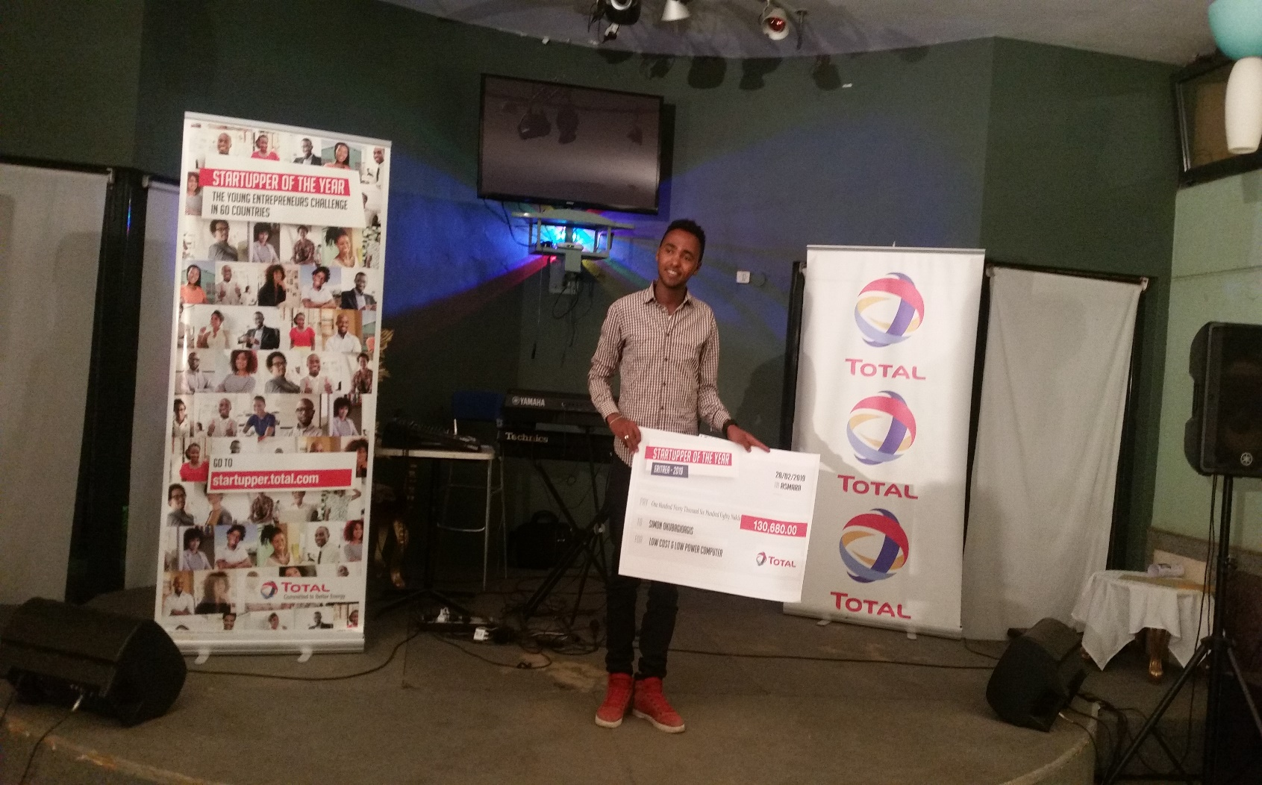
Successes & rewards
EIT: Best Project of the Year
Total International competition: 2nd Startupper of the year
Eritrea Sawa Festival: 3rd Best Project of the Year

